Slide 1

R
ResQAI
AI-Driven Emergency Response
and Resource Coordination

Slide 2
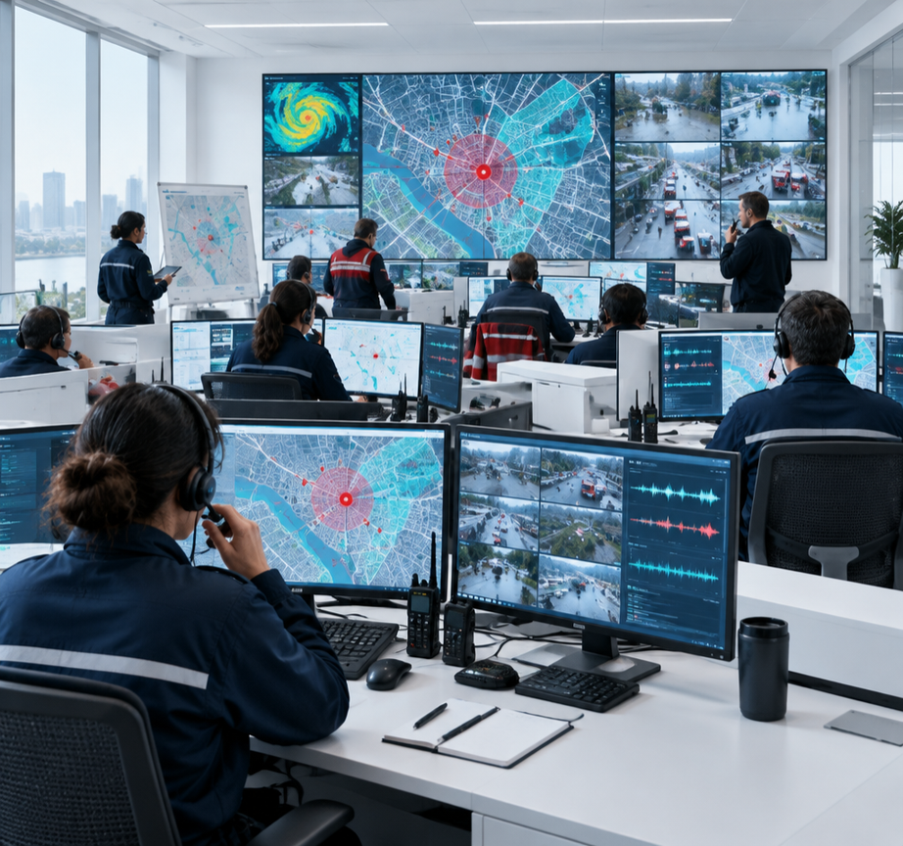
Challenges in Emergency Response
01
Fragmented reporting
slows timely action
02
Citizen reporting barriers:
app installs, logins
03
Duplicate and low-quality alerts
overwhelm operators

Slide 3
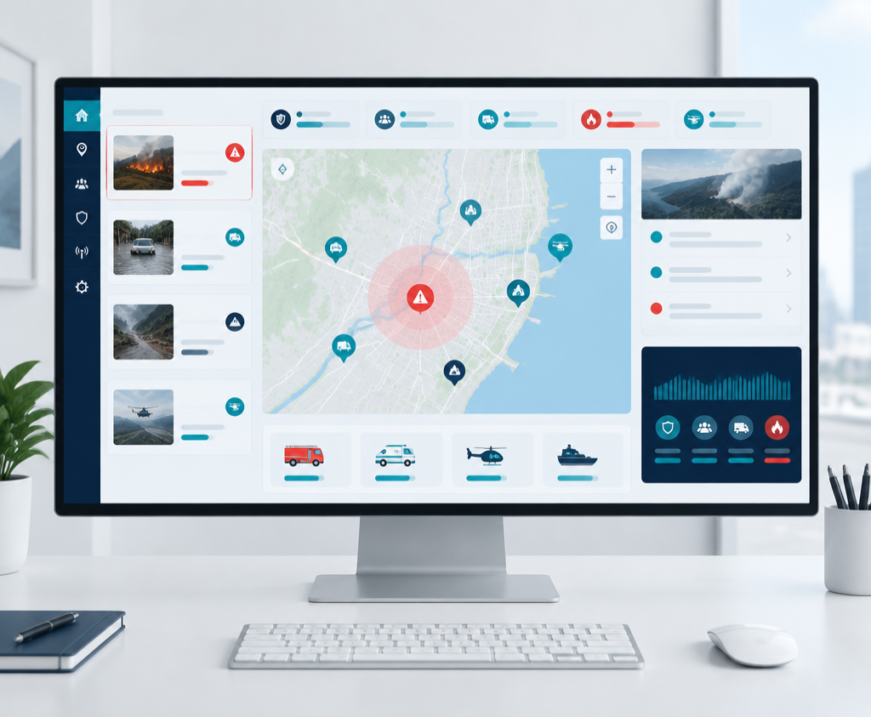
ResQAI Simplifies and Accelerates Emergency Response
01 Detect
AI-assisted incident detection from incoming reports.
02 Report
No account or app required for citizen reporting.
03 Coordinate
Resource suggestions remain under operator oversight.

Slide 4
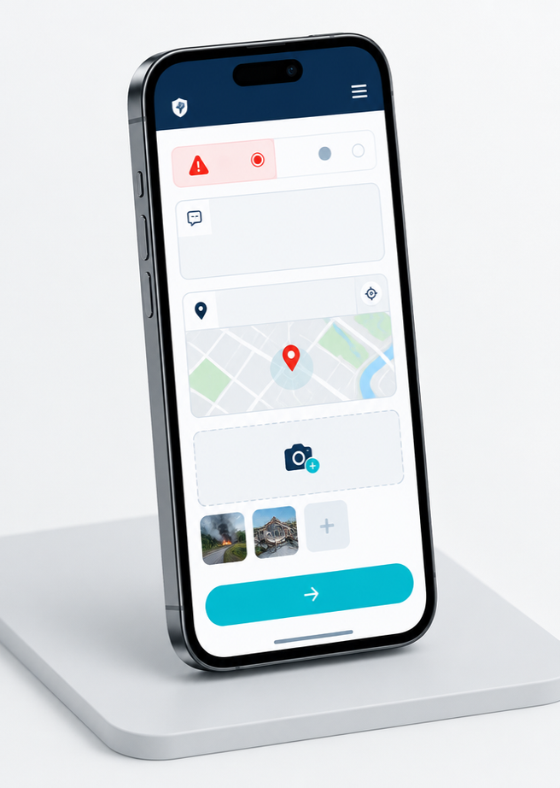
Report Emergencies Instantly — No Login, No Install
Designed to remove friction at the moment it matters most.
Web link or SMS
Guided, simple prompts
Location tagging + photo upload

Slide 5
AI Pipeline Powers Accurate Incident Detection
01
02
03
CLASSIFICATION
Report type
SEVERITY
Urgency signals
DUPLICATE DETECTION
Similar reports
Fire · accident · medical
Priority cues for review
Clusters reduce noise
Illustrative AI workflow — operator review remains essential.

Slide 6
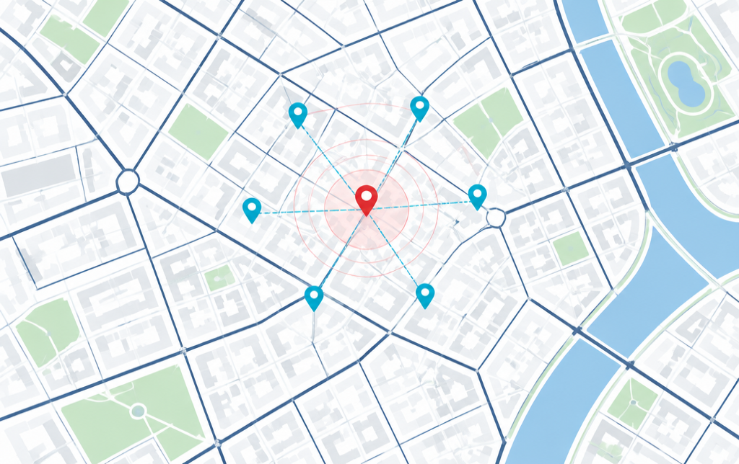
One Incident, Multiple Reports — Clearer Situational Awareness
ILLUSTRATIVE EXAMPLE
5 reports
→ 1 incident
Nearby, similar reports can be grouped into one operator-ready incident view—reducing noise while preserving source evidence.
Demo visualization only

Slide 7
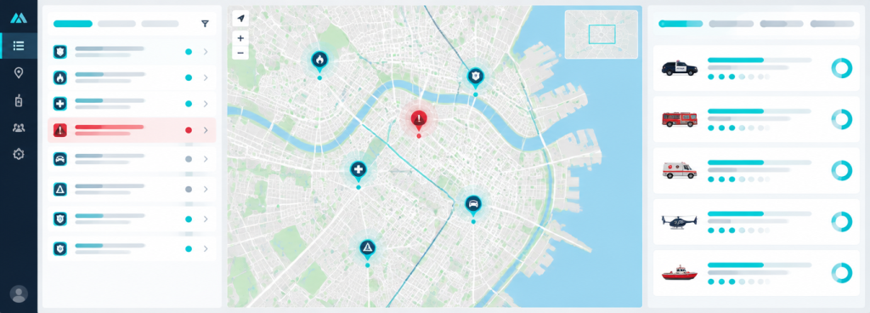
Command Center: Secure, Intuitive Incident Management
Secure access
Live incident tracking
Integrated communication

Slide 8
Coordinated Response with Human-in-the-Loop Dispatch
AI + OPERATOR REVIEW
Confirm incident
RESOURCE SUGGESTIONS
Availability + proximity
HUMAN APPROVAL
Simulate dispatch
Evidence stays visible
Recommendations, not orders
No automatic live dispatch
Prototype boundary: suggestions and dispatch are demonstrated in simulation mode only.

Slide 9
Robust, Scalable Architecture
CITIZEN PWA
BACKEND / API
AI MICROSERVICES
Classification · severity · duplicate detection
MAPPING UI
DATABASE
ROUTING · OPTIONAL

Slide 10
Building Trust and Ensuring Safety
Privacy first
Secured console
No citizen account required; minimize retained personal data.
Authentication gates operator tools and sensitive incident views.
Prototype scope
Augment, not replace
No live emergency notifications or official dispatch.
Designed to support—not substitute—existing emergency services.

Slide 11
Impact So Far & Path Forward
ILLUSTRATIVE DEMO DATA
Q4 2026
Extended model training
+ UI enhancements
128
sample reports processed
Q1 2027
Integration pilot
(demo mode)
34
demo incidents clustered
Q2 2027
Resource coordination
+ analytics
Not validated performance claims

Slide 12
ResQAI
Smarter. Faster. Safer.
Emergency response.
THANK YOU

